Slide 1
Image Captioning…

Slide 2
Objective:
Development of a predictive caption model for uploaded images:
Predicting the caption of images
Easy to captioned

Slide 3
Data :
Text file contains
Image Names
Respective Caption for images

Slide 4
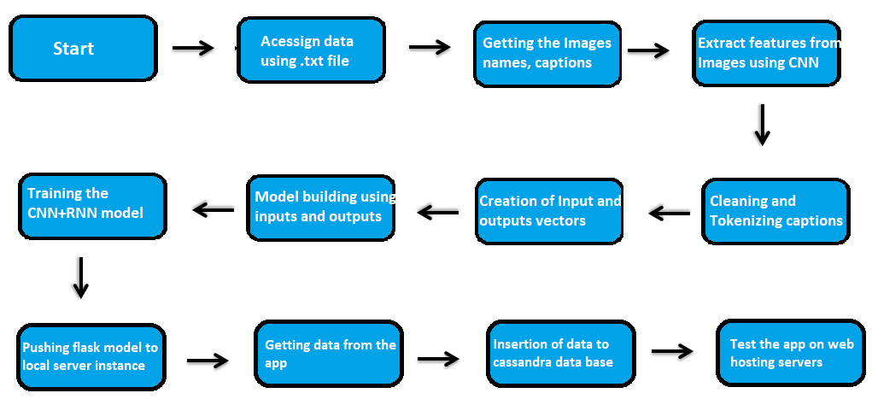
Architecture

Slide 5
Data Validation and Data Transformation :
Name Validation – Validation of the file using the file open and read functions.
Find the image names and captions in file and save them in separate files.
Cleaning the image file names
Using NLTK and functions clean the caption and create the vector form using
Keras Tokenizer and pad sequences
Using Keras Xception model get the features of the images.
Gather both the image features , caption sequences and make the input and output data.

Slide 6
Model Training:
Data Import from local memory :
The accumulated data from memory is exported in txt for model training
Data Preprocessing
Performing EDA to get insight of data like removing the urls, html_tags, word corrections,
Removing stop words, tokenization, and pad the sequences with max length of text.
Using Keras Xception model to get the image features
Combine both of the data to create the input and output vector.

Slide 7
Model Selection –
Deploying models
- Create the combine CNN and RNN model using the Keras Xception model as CNN and LSTM layers to create the RNN model and train the model for the necessary epochs and use the same model to predict.

Slide 8
Prediction:
The testing files are shared in the batches and we perform the same Validation operations ,data transformation and data insertion on them.
The accumulated images from local file system is to be exported .jpg/.jpeg for prediction
We perform data pre-processing techniques on it.
Model created during training is loaded for the preprocessed data is predicted
Once the prediction is done for all the testing data. The predictions are saved in csv format and shared.

Slide 9
Data Insertion in Database:
Table creation :- Table name “Image captions" is created in the database for inserting the files. If the table is already present then new files are inserted in the same table.
Insertion of files in the table - All the files in the user interface are to be inserted along with the prediction result in the above-created table.

Slide 10
Q & A:
Q1) What’s the source of data?
The data for training is provided by the client in txt and image format
Q 2) What was the type of data?
The data was the combination of Textual and images.

Slide 11
Q 3) How logs are managed?
We are using different logs as per the steps that we follow in validation and
modeling like File validation log , Data Insertion ,Model Training log , prediction log
etc.
Q 4) What techniques were you using for data pre-processing?
Performing EDA to get insight of data like removing the urls, html_tags, word corrections,
Removing stop words, tokenization, and pad the sequences with max length of text.

Slide 12
Q 5) How training was done or what models were used?
Divide the data to training and validation data.
CNN + RNN trained on the training data for testing.
Q 6) How Prediction was done?
The testing files are shared by the user .We Perform the same life cycle till the data preprocessing. In the end we get the accumulated data of predictions.

Slide 13
Q 7) What are the different stages of deployment?
When the model is ready we deploy it in local environment or AWS, GCP or Azure .(Here used only local environment and Render Live host.)

